Slide 1

Agile Presentation
SNHU CS250
William Wootton

Slide 2
Agile Roles
Product Owner
Scrum Master
Development Team Member
Development Team Member
Development Team Member

Slide 3
Agile Roles Described
Product Owner
-As a product owner you are required to provide a basis for your product and at the least an overview of how you wish your product to be handled.
-You must effectively communicate with the scrum master to address any issues or problems that may occur during the implementation of the product, and must listen to and address and new ideas brought forward by the scrum master
Development Team Member
-As a development team member you may be assigned on of many roles to play in the development cycle. Anywhere from a tester, to designer, to developer you must accurately and diligently perform whichever duty you are given to ensure the best quality for your product.
-Your role will not impact your communication, you will communicate directly with your scrum master and other members of the development team to work together through challenges and form new ideas to improve the product.
-You may be given the role of tester which requires you to investigate the product to find any bugs or overall issues with the product, these may include but are not limited to things such as difficulty using, understand, or UI mistakes.
-Another role you may be given is that of a developer who actively works inside the code bringing to life the ideas that were previously presented. The developers must work to actively finish tasks given to them by the scrum master and must convey any issues they may run into or ideas they may gain during a daily scrum meeting.
Scrum Master
-As a scrum master you must communicate with both your development team and the product owner to determine the best course of action for the product
-You must assign tasks for your team and ensure that you are on track for staying within the budget and time frame given
-You must effectively communicate any new ideas of issues the team discovers during the development process

Slide 4
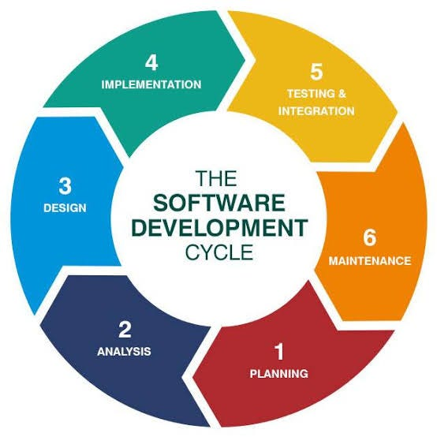
Agile Phases
This is a diagram demonstrating the basics of the SDLC inside of a Scrum-Agile framework.
-Planning is the first step where the product manager will discuss and address what exactly the product should be and what thing it should tackle. This is important as it lays the foundation for the entire project
-Analysis is used to discuss how feasible the ideas produced inside the planning stage are, and then these ideas will be shaped to be better understood and clear for the product going forward
-Design consists of the team discussing and brainstorming the framework of the product and how to go about tackling the tasks ahead
-Implementation means the team can get to work implementing the tasks that have been formed previously into a working element of the product as a whole
-Testing requires the team to evaluate the new additions to notice any flaws in the product or bugs that may have arisen from new implementation of features
-Integration causes the team to then fix any issues discovered during testing and address all these issues before the next sprint.
-Maintenance allows a team to fully address any more issues found or any outdated piece of code that can be simplified, or improved upon
The SDLC will be iterated through as many times as needed until the product is considered finished and rolled out to consumers, however it may never stop. As new software comes out updates will need to be pushed and if any new issues or problems arise from customers and the product owners the team may need to address them to ensure the product stays top of the line and at its full ability at all times.

Slide 5
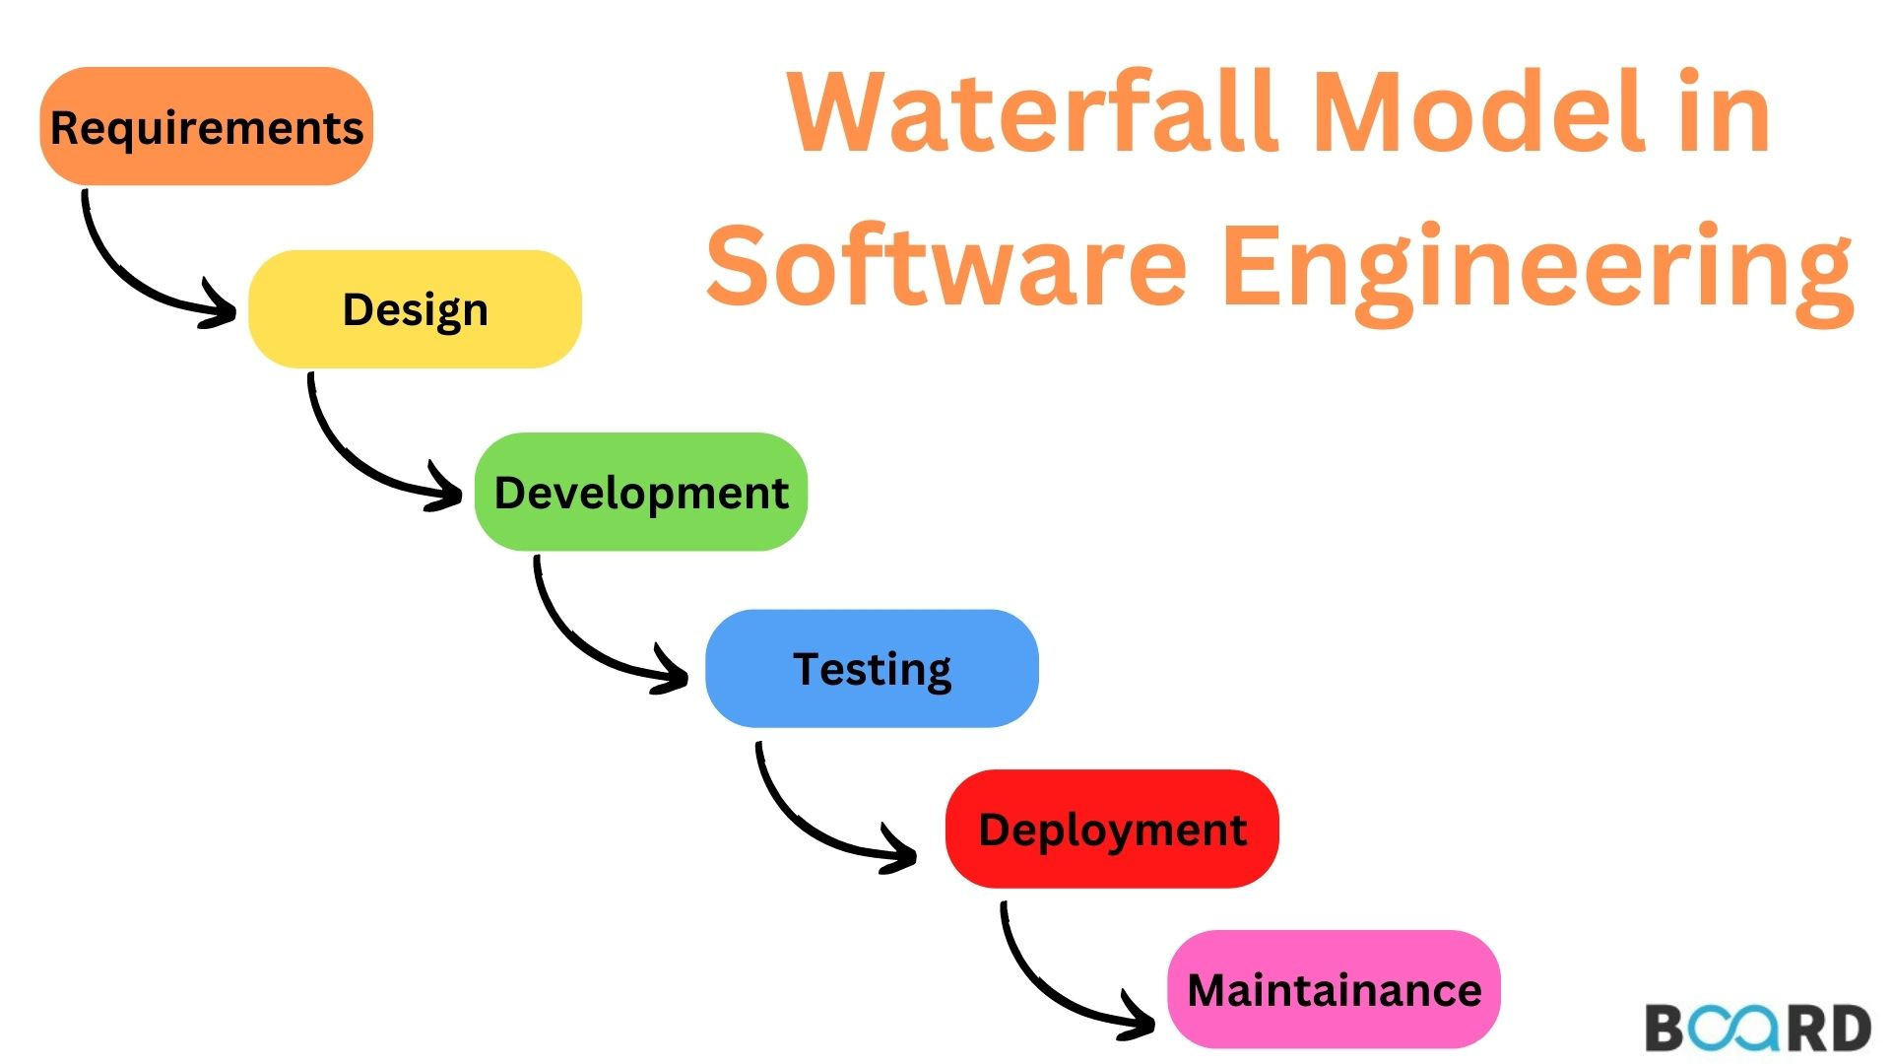
Waterfall Model
-Inside a waterfall model, each stage is completed once, and each stage may only begin when the previous stage has been completed. This allows for a rigid structured way of design that often limits adaptability and any necessary changes that may be found during the development process
-When working on the project for SNHU Travel the team discovered that when publishing images to show the top 5 destinations we wanted to change and adapt the layout to be different as we changed and discussed what better ways to implement the idea of top 5 destinations. During a waterfall method these changes wouldn't have been allowed to happen as since we had moved to the development stage we could not return to the design stage to make the adjustments required to improve the layout of the design

Slide 6
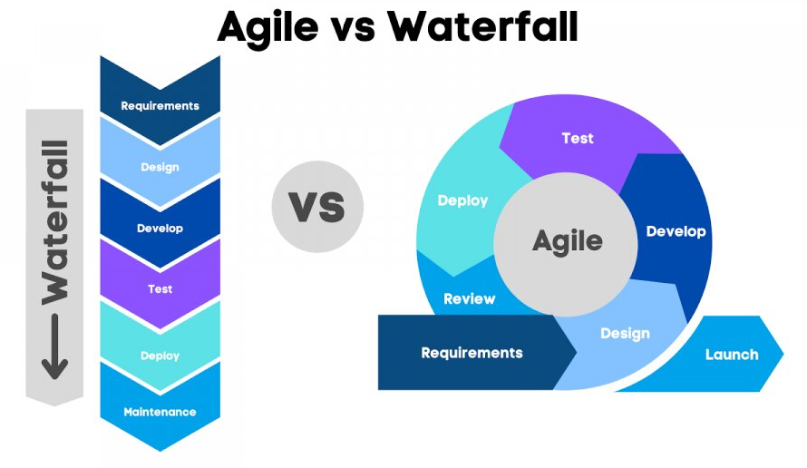
Waterfall or Agile
-Out of the 2 both can be useful and work to help development the product you wish to implement. If you wish to have a structured cycle where the product may look exactly as you envisioned it or, if your stakeholders and product owner are stubborn and do not wish any changes to be made then the waterfall method may be best.
-However in most situations teams will benefit most from adopting and agile style focus to design. It allows for flexibility and the ability to take in feedback from both your development team as well as users who are actively testing the product. This can create and build a community around your product that feels as though they can be heard by your team and can see their own problems with the product changed and fixed over time.
-In the end for this project specifically the team benefitted greatly from using and agile style development cycle, that allowed for users to be heard, changes to be made, and issues to be fixed on the fly by the team.

Slide 7
Sources
Zhezherau, A. (2025b, April 14). The benefits & Advantages of Agile: Wrike agile guide. Versatile & Robust Project Management Software. https://www.wrike.com/agile-guide/benefits-of-agile/
Ferreira, A. (2023, October 31). Deep Dive: The software development life cycle (SDLC) in Agile Environments. Medium. https://medium.com/@argferreira1/deep-dive-the-software-development-life-cycle-sdlc-in-agile-environments-6b245bbea5ab
Board Infinity. (2023, July 12). Waterfall model in software engineering. https://www.boardinfinity.com/blog/a-quick-guide-to-arrays-in-python/
Datavalley Inc. (2023, January 31). Waterfall vs agile: Which is better for you and why?. LinkedIn. https://www.linkedin.com/pulse/waterfall-vs-agile-which-better-you-why-datacademy-cloud

